Slide 1

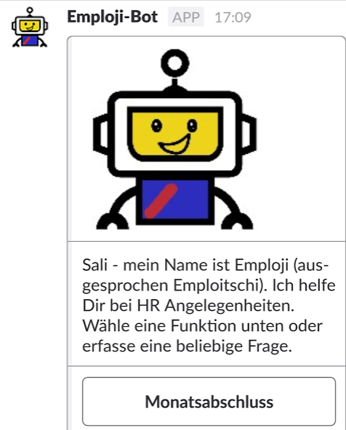
Folienbibliothek
Making life easier
for AXA employees.
Vorlagen
AXA internal Hackathon 2017 – Emploji Team

Slide 2
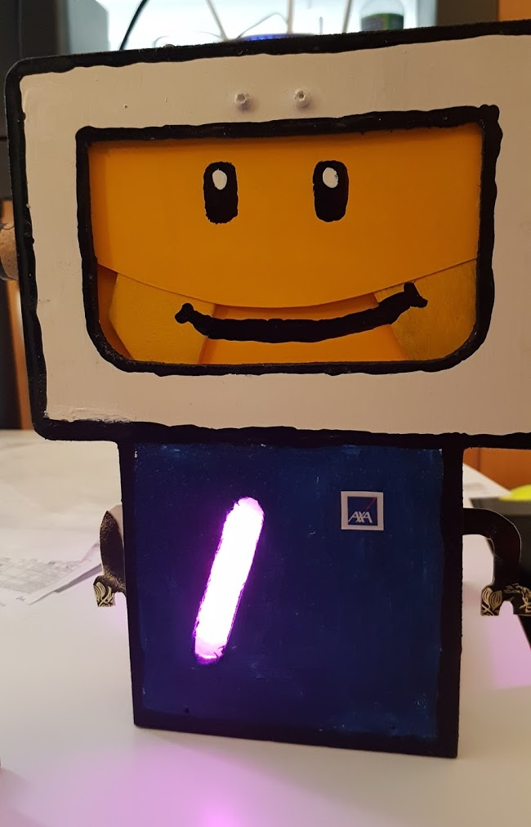
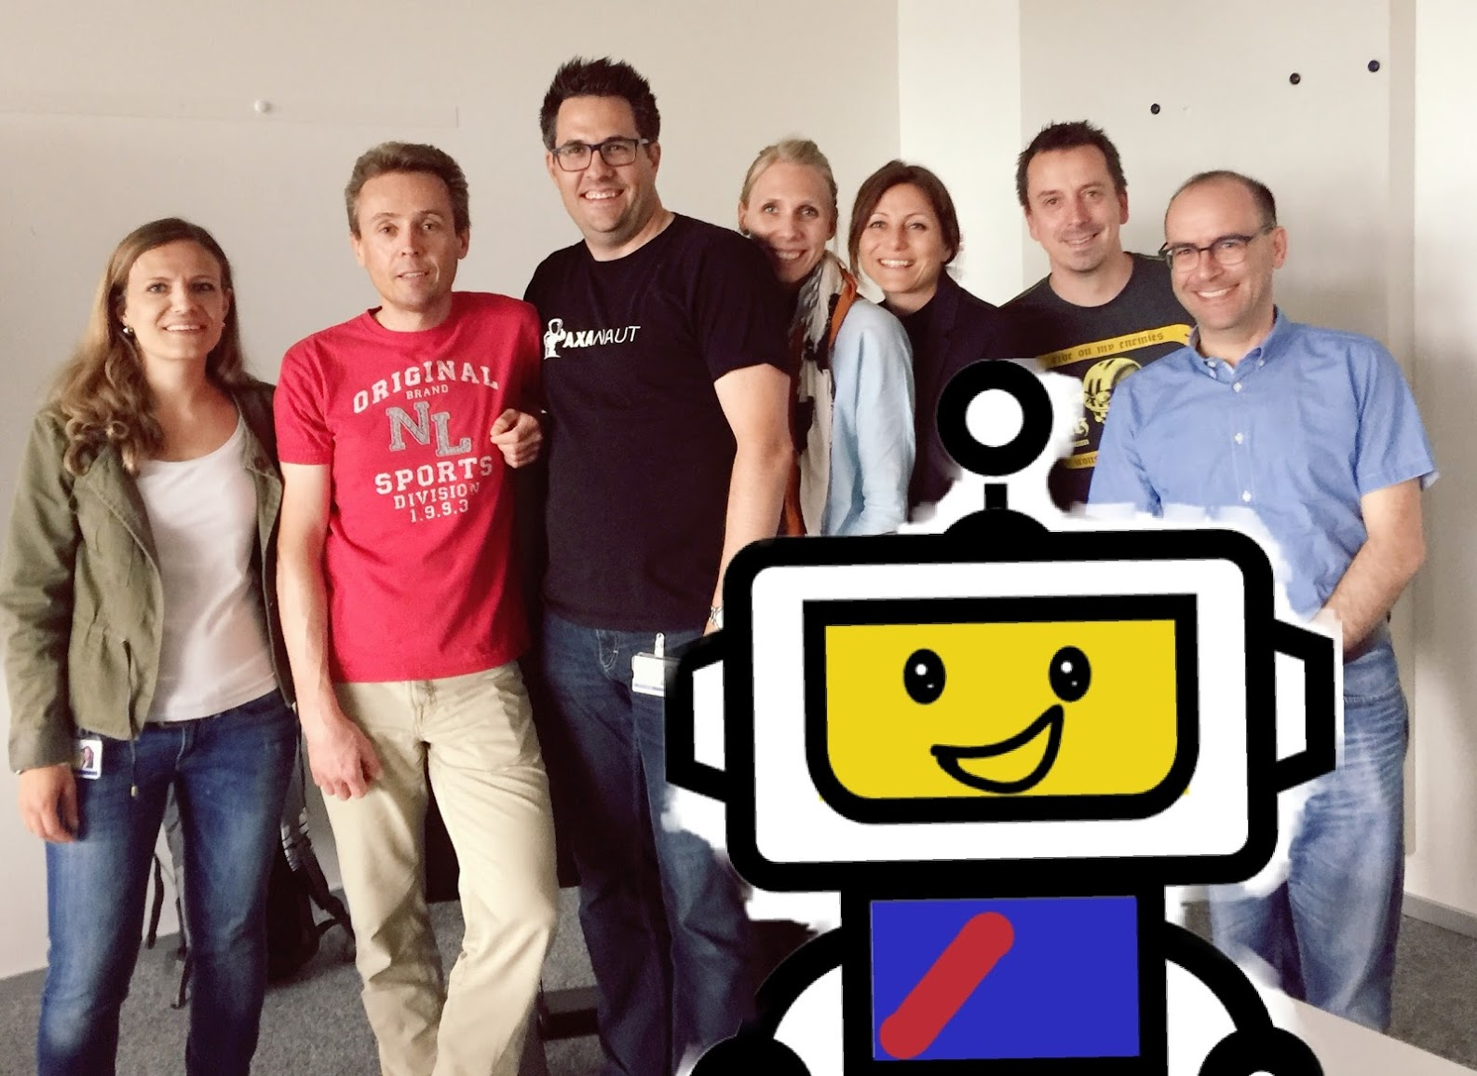

Emploji wins the AXA Hackathon 2017
Formerly known as «Focus Days»

Slide 3
What is the AXA Hackathon?
Formerly known as “Focus Days”
AXA Internal Hackathon within AXA Switzerland
AXA Winterthur + AXA Group Solutions + AXA tech. service
Idea
Employees are working 2 days (40h) on a new innovative topic
It is handled as a training day
2013: Started as an IT Hackathon (19 attendees, 3 teams)
2016: open for all employees – Business and IT collaboration
2017 already the 5th edition (60 attendees, 7 teams)
from Innovation to Implementation
Every year 2 ideas are ending up in an implemented feature

Slide 4

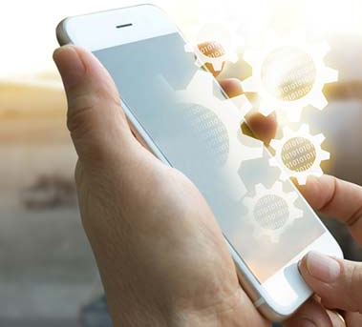
What is the idea behind Emploji?
Employee Experience
Tag Line: «Make Life easier for AXA employees»
Current pain points
Employees expect the same comfort with HR tools as with their Mobile phone
Current HR tools user experience is bad
HR processes are time consuming and annoying (e.g. Administration of expenses, absences, time reporting)
No quick answers to simple questions
Value proposition
intuitive simplification of HR administrative tasks
User Experience for employees
HR as 7x24 service
HR-Chatbot does speed up HR processes
Digitalization of processes (also Onboarding tasks, online training, polls...)
Chatbots are not a hype – they are reality
Notes:
Pain:
In their private live employees are used to chats and superior mobile experience, and they expect the same comfort with HR too
Our Employee tools today have a bad User Experience
Consumerization of IT is playing an import role > ck Erklärung mit Lolo
With today’s HR tools, the administration of expenses, absences, time reporting and other mandatory tasks are time consuming and annoying
Wildcard search in Intranet ONE is not properly working therefore employees send emails or call HR staff.
according to Radicati Group average business user gets 88 emails per day.
in recent Sharp business study nearly half of the respondents replied, that their engagement would raise if the software used at work would be easier to use, 43% overall vs 49% under 35 year olds.
Value proposition:
easy to read messages, you can even talk to the bot so no writing required, you do not need ot log in and do not have to think on regular tasks as the bot will notify you.
keep employees engaged e.g. with a onboarding process guided by Emploji.
We have the possibility of flexible working hours, so I can go at home early, bring the kids to bed, log in to finish work and could reach the bot in case I have a question.
our employees have more time to spend on our customers and we as HR will have more time to spend on valueable service for our employees.
Push notifications could be used to spread important information for our employees – or with pull messages we could add subscription for certain topic.
HR has to answer repetitive questions once as the bot will learn the question and reply and have it ready for next employee

Slide 5

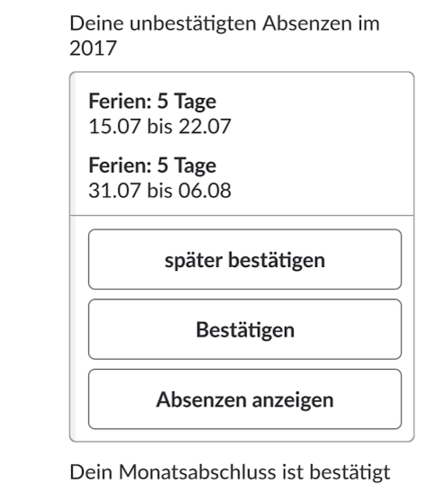
Emploji – Prototype functionalities
Make life easier for AXA employees
Use simple sentences / questions
manage expenses, absences and monthly confirmation
get answers to HR questions / FAQ
What are the Bank holidays in 2017
I will be Daddy soon
Can I attend a Feedback-
Training next month?
I am on Holiday starting
1st Aug for 2 weeks
I was ill on
3rd of April
Notes:
Create an expense starting via uploading a receipt
I am getting married, I move, My kid is sick
How many days do I have for maternity leave?
How many holidays are left?
How many days of training I had this year?
→ Simplify Life of HR & Employees

Slide 6

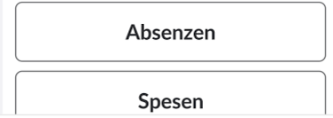
Demo

Slide 7

Emploji – what’s next
Key takeaway's
Emploji received the most votes - seems to be a good idea
User Experience is important to our employees
Cross-functional team was very efficient
Within 2 days we succeeded to implement 3 simple processes and can answer FAQ
Priority?
Emploji – is a business innovation – bringing Innovation to HR
Next steps
Priority & Resources within HR (CH, DE, Group)?
Innovation Phase 1 (STEAM):
Get the funding for a 3 months prototype 30’000 CHF Success or failure?
Evaluate poss. Provider, Calculate Business Case, define MVP
Innovation Phase 2 (BEAM):
Pitch for MVP implementation
Financing?
Support from Innovation?
Notes:
ONE AXA : Kai Pika interessiert > Presentation forwarded 2 Regina Oberfeld
Simplify Life of HR & Employees

Slide 8
Savings potential - Switzerland
Absences / year: 65’000
Time spent on absence request: 5’
Expense booking / year: 30’650
Time spent on expense booking: 10’
677 Working days
639 working days
4 FTE > CHF 480’000.--

